Slide 1









Novel electrophysiological biomarkers of epileptogenicity and cortical excitability

Slide 2
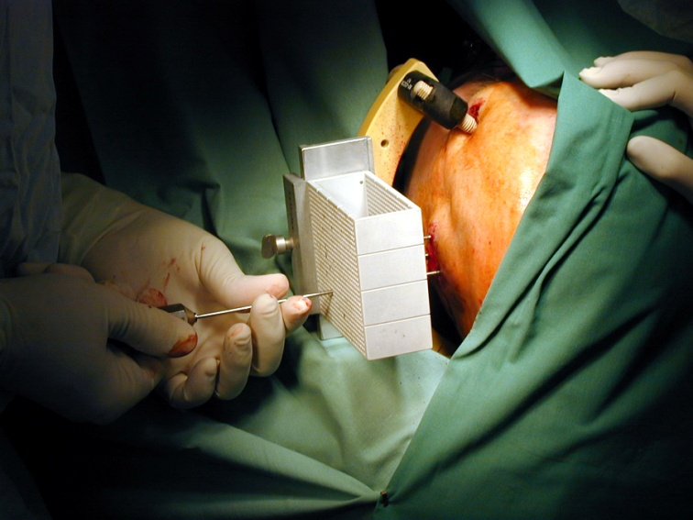
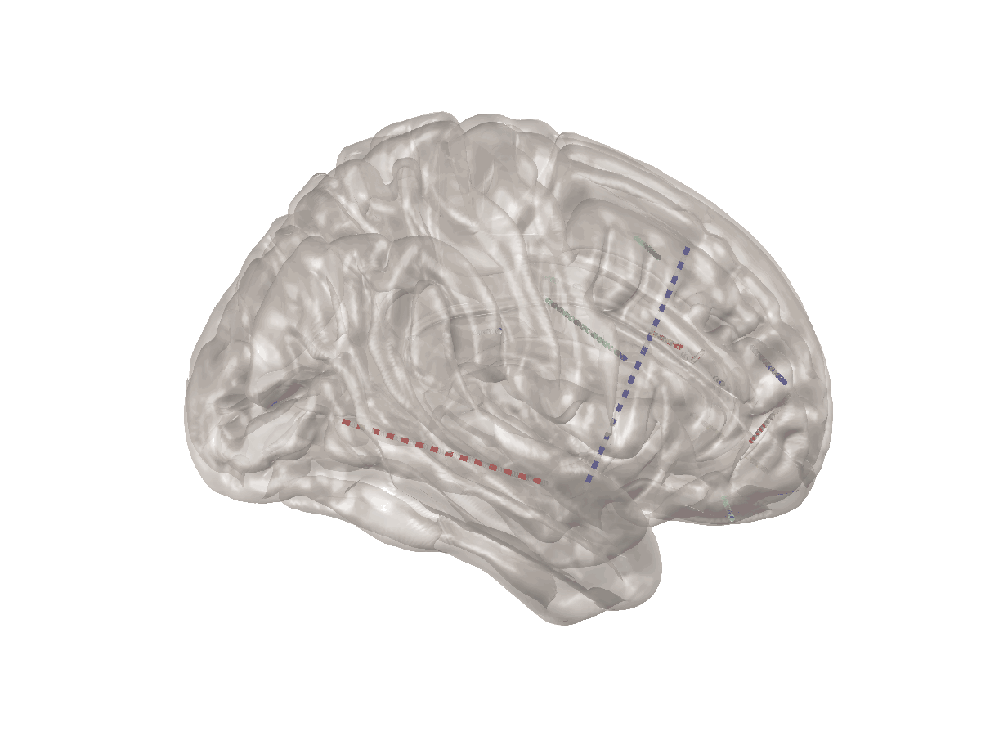
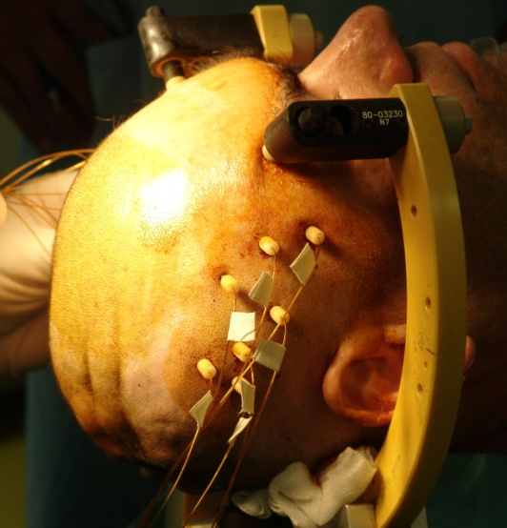
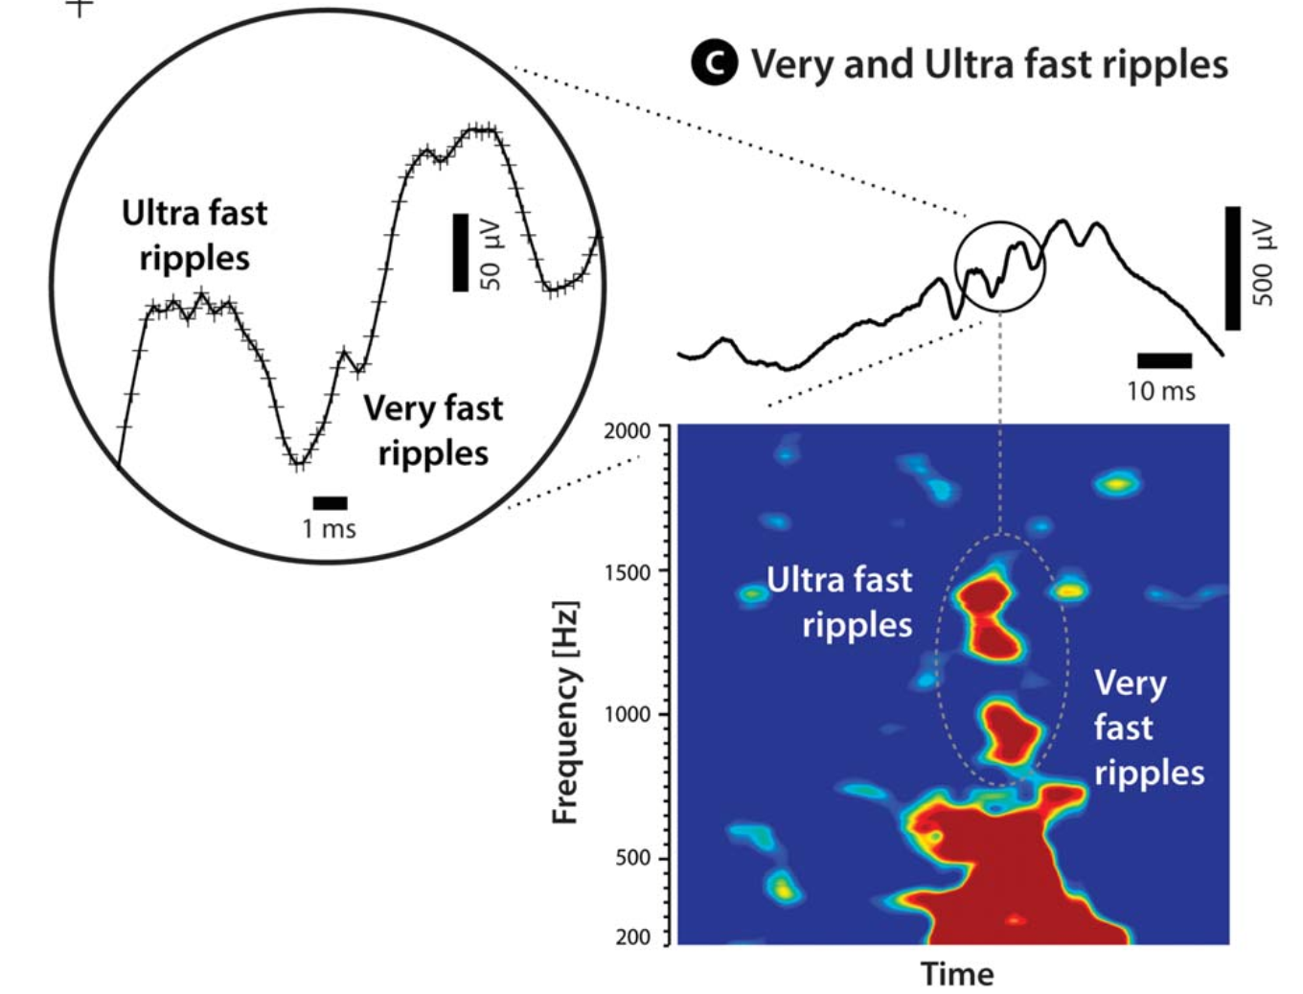
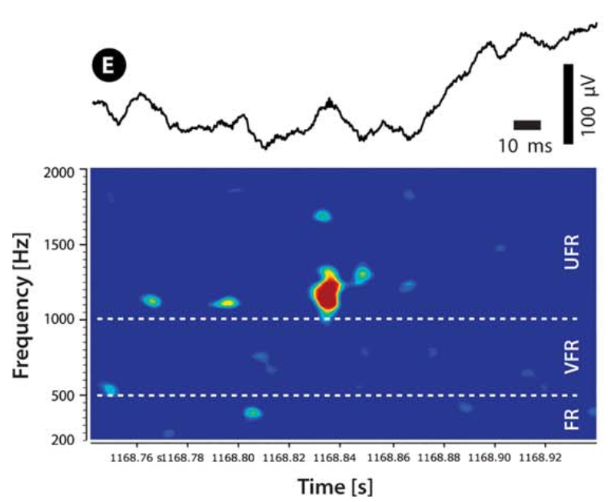
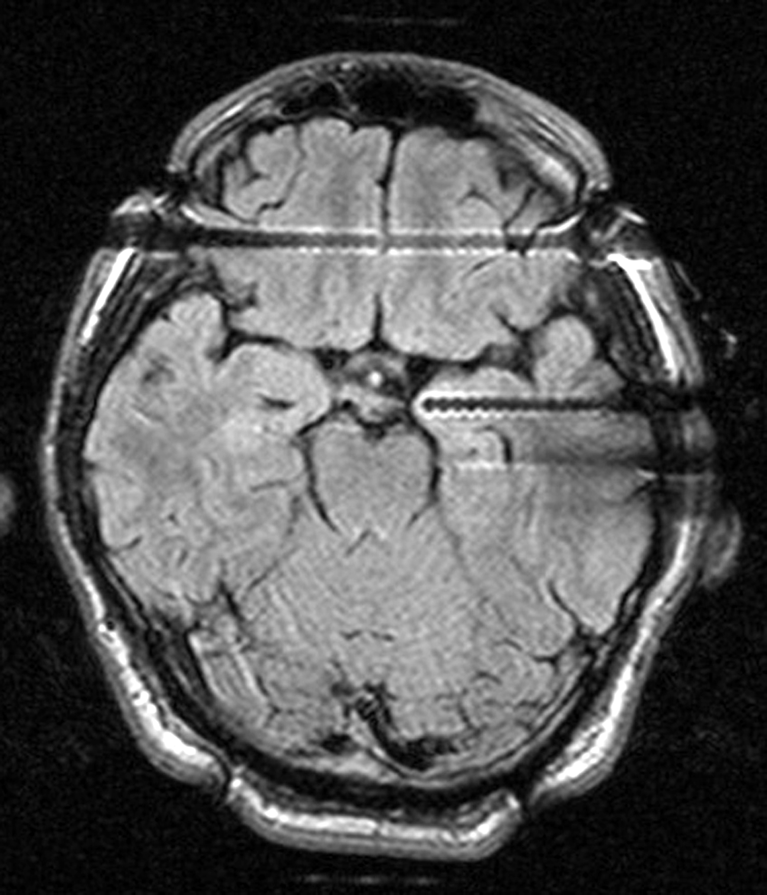
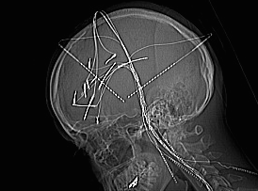
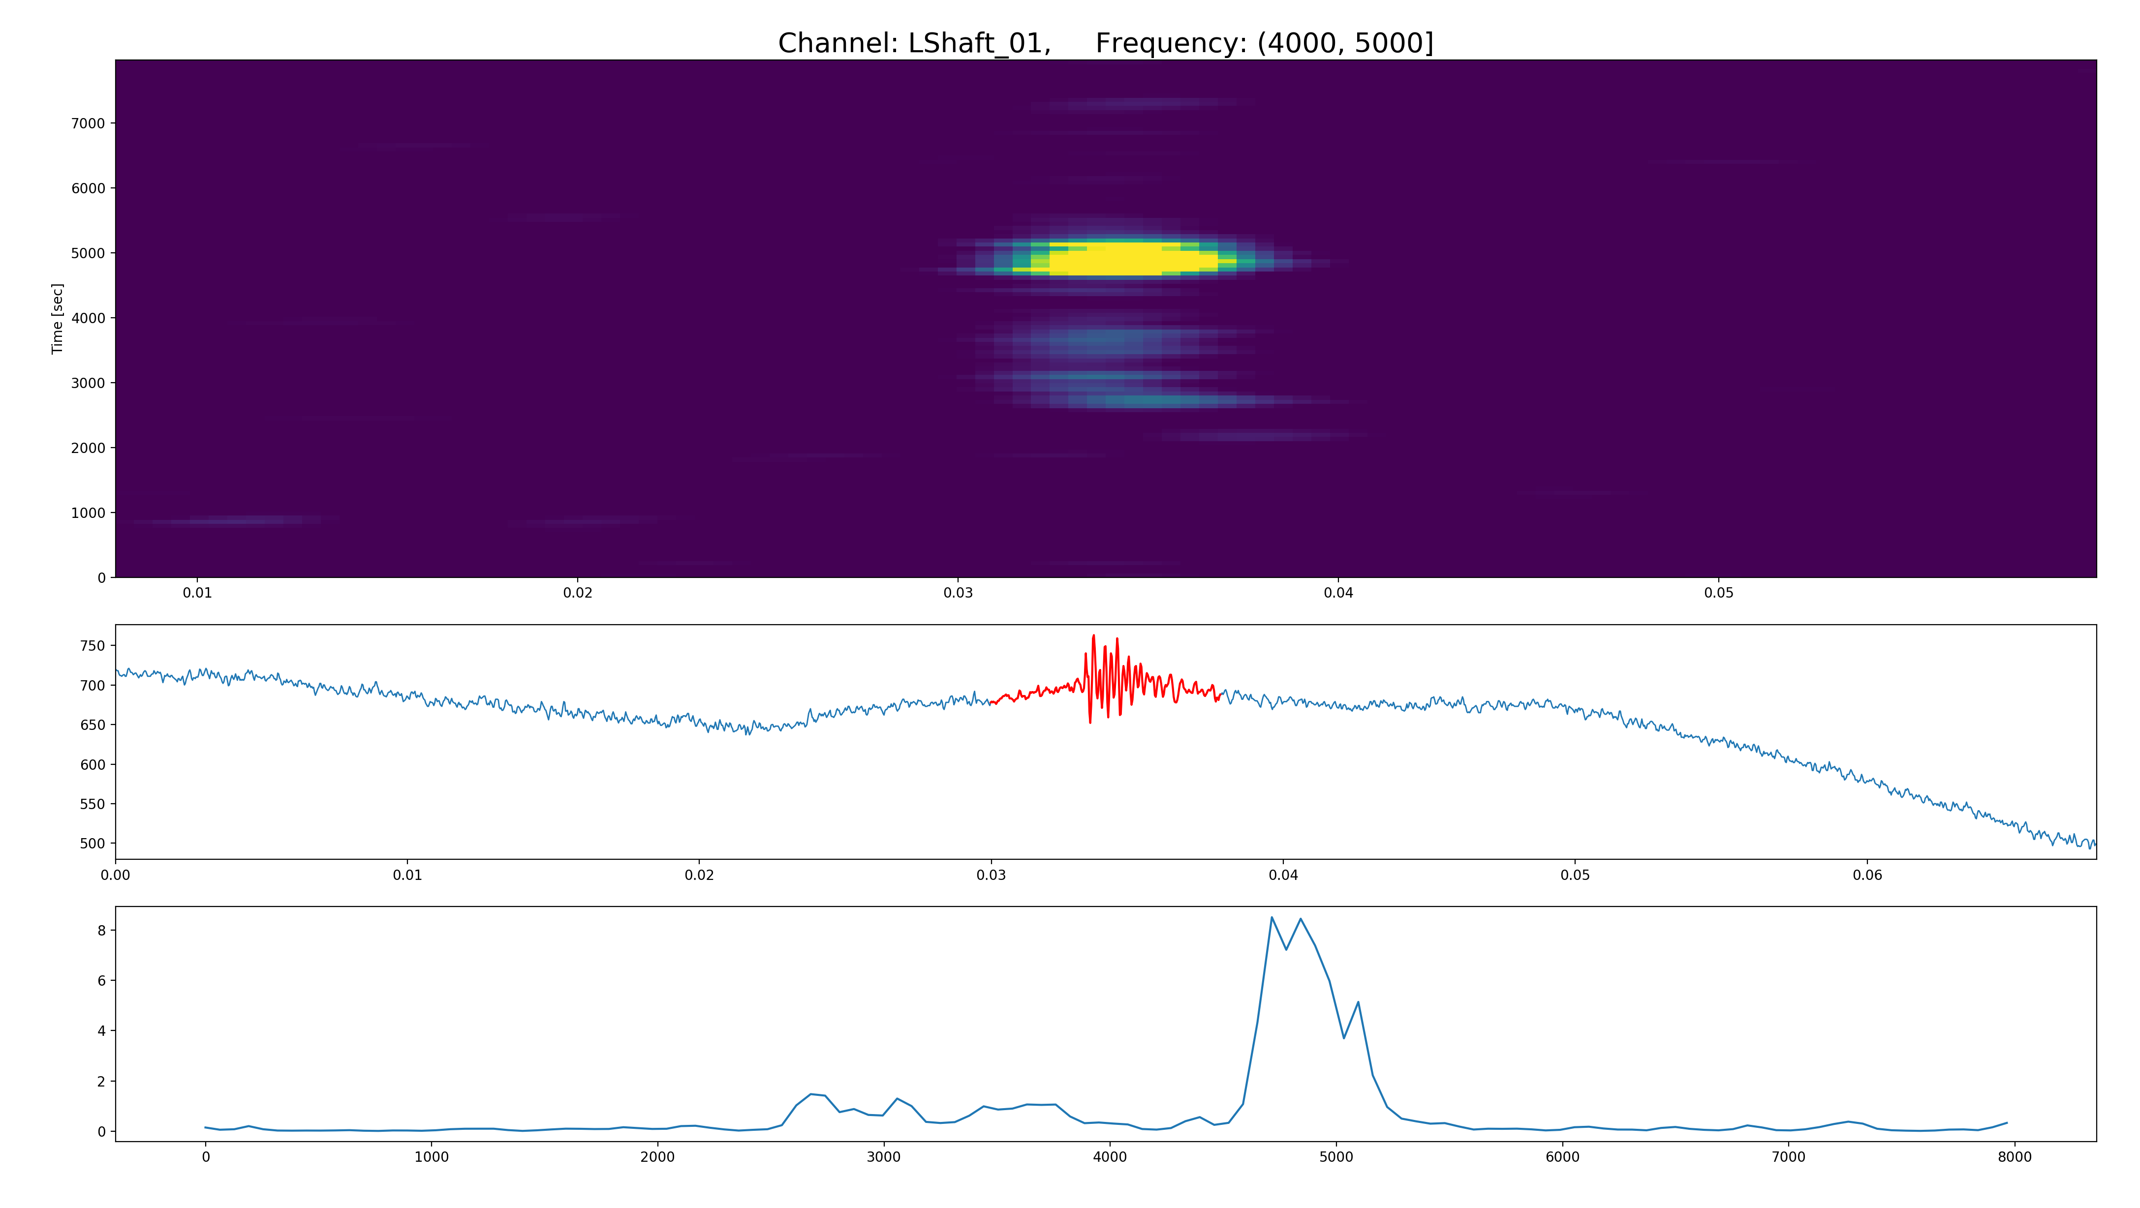
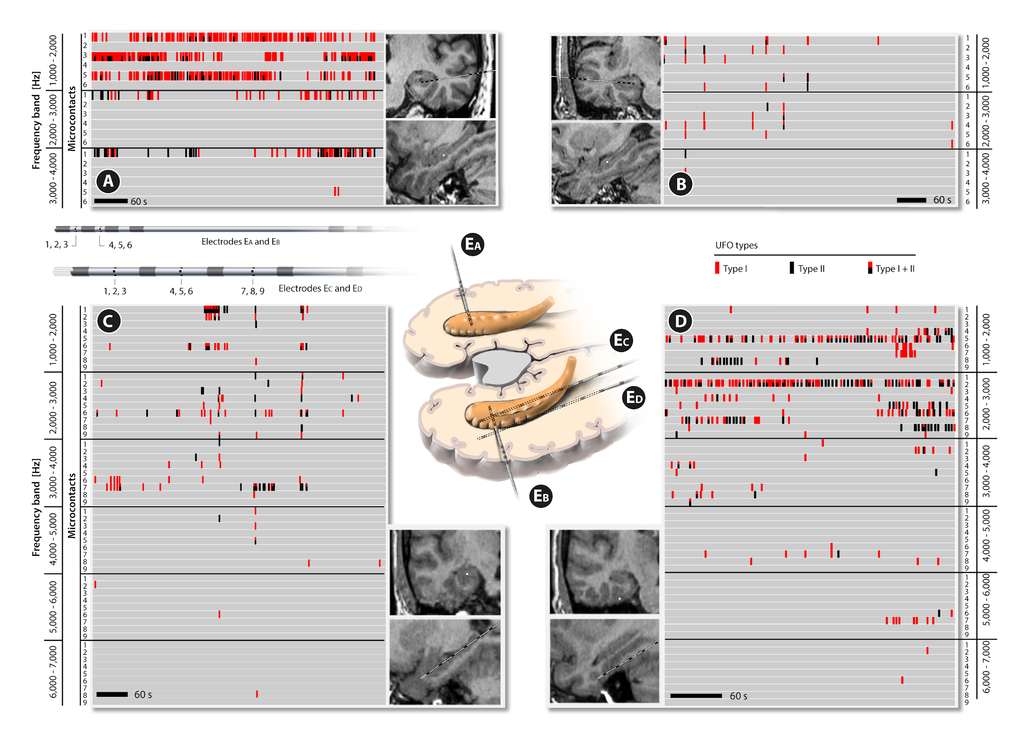
Human intracerebral EEG recordings in vivo
(depth macro- and microelectrodes)
macrorecordings
Brazdil et al, Epilepsy Res 2010
Pail et al, Clin Neurophysiol 2013
Brazdil et al, BMC Neurosci 2015
Pail et al, Clin Neurophysiol 2017
Rehulka et al, Clin Neurophysiol 2019
Klimes et al, Epilepsia 2019
Cimbalnik et al, Clin Neurophysiol 2019
Cimbalnik et al, Front Neurol 2020
Pail et al, Sci Rep 2020
HFOs
High
Frequency
Oscillations
VHFOs
Very
High
Frequency
Oscillations
UFOs
Ultra
Fast
Oscillations
80 - 500 Hz
R FR
macrorecordings
Brazdil et al, Ann Neurol, 2017
500 - 2,000 Hz
microrecordings
8
7
6
5
4
3
2
1
0
TFA
2-8 kHz
Paper in preparation
1 ms

Slide 3
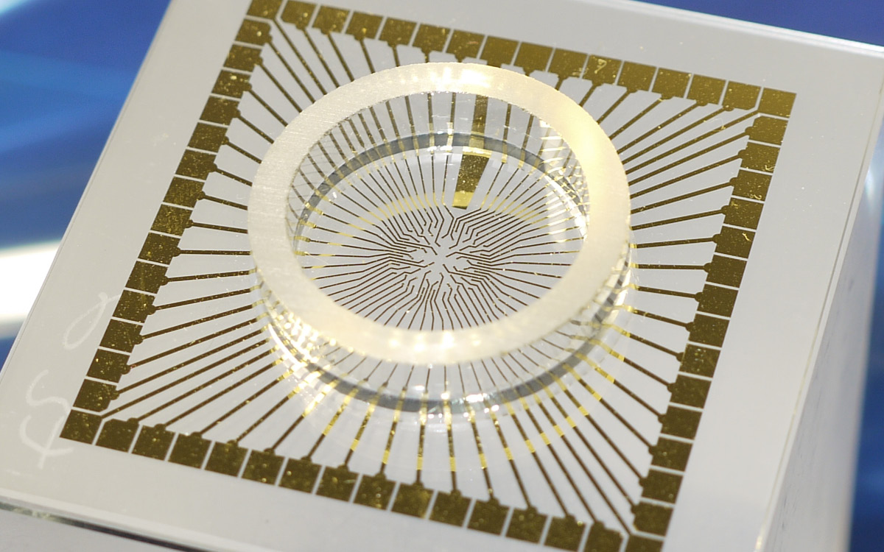
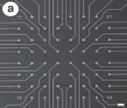



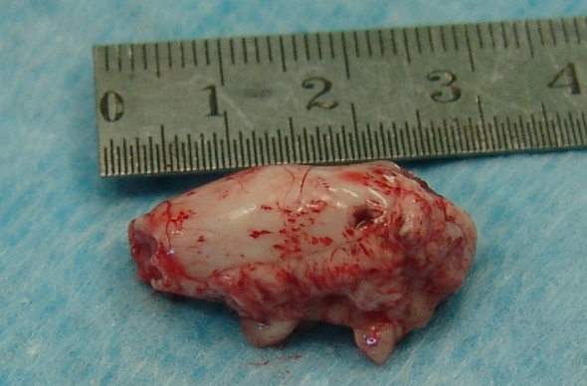
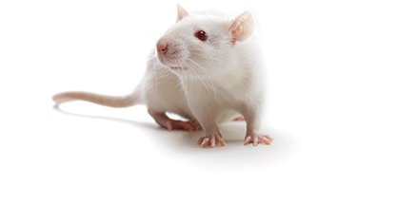
Human intracerebral EEG recordings in vivo
(depth macro- and microelectrodes)
Extracellular EEG recordings in vitro
(microelectrode array)
macrorecordings
Brazdil et al, Epilepsy Res 2010
Pail et al, Clin Neurophysiol 2013
Brazdil et al, BMC Neurosci 2015
Pail et al, Clin Neurophysiol 2017
Rehulka et al, Clin Neurophysiol 2019
Klimes et al, Epilepsia 2019
Cimbalnik et al, Clin Neurophysiol 2019
Cimbalnik et al, Front Neurol 2020
Pail et al, Sci Rep 2020
HFOs
High
Frequency
Oscillations
VHFOs
Very
High
Frequency
Oscillations
UFOs
Ultra
Fast
Oscillations
80 - 500 Hz
R FR
100 μm
Human brain slices
Primary neuronal cultures
iPSC derived neuronal cultures
macrorecordings
Brazdil et al, Ann Neurol, 2017
500 - 2,000 Hz
microrecordings
8
7
6
5
4
3
2
1
0
TFA
2-8 kHz
Paper in preparation
1 ms

Slide 4

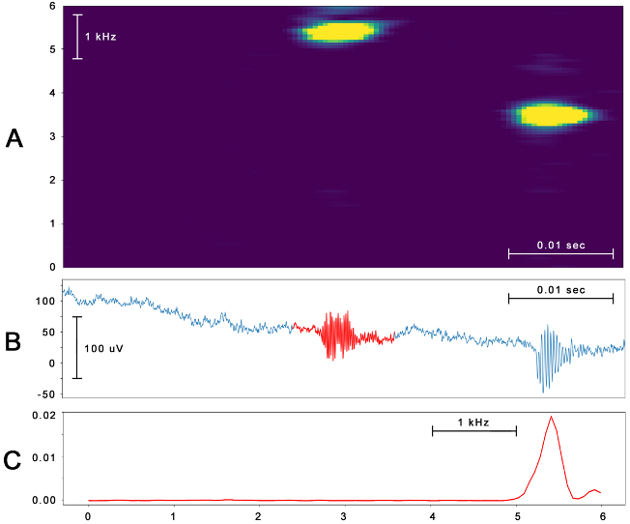
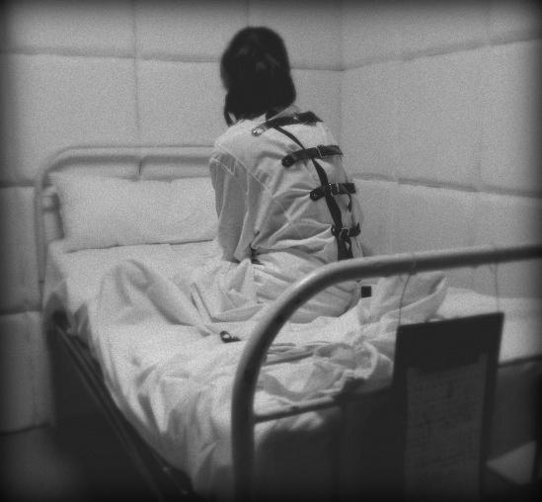
?

Slide 5
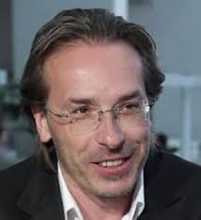
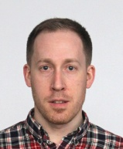
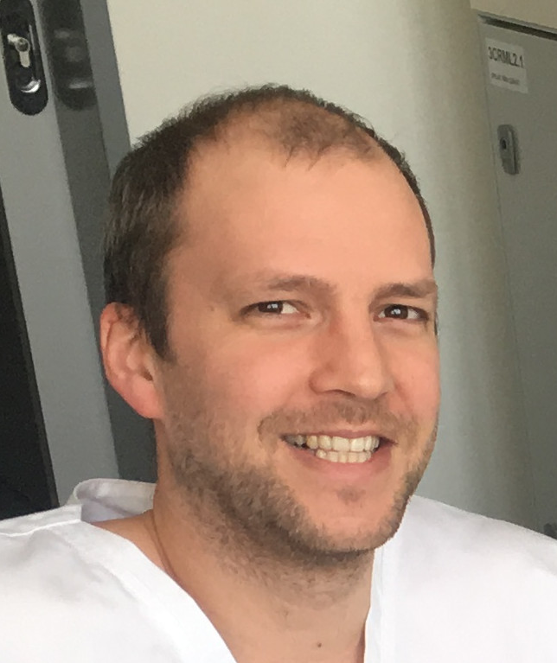
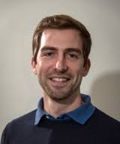
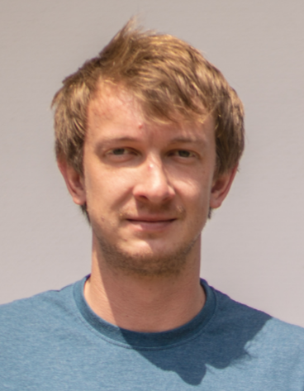
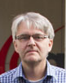
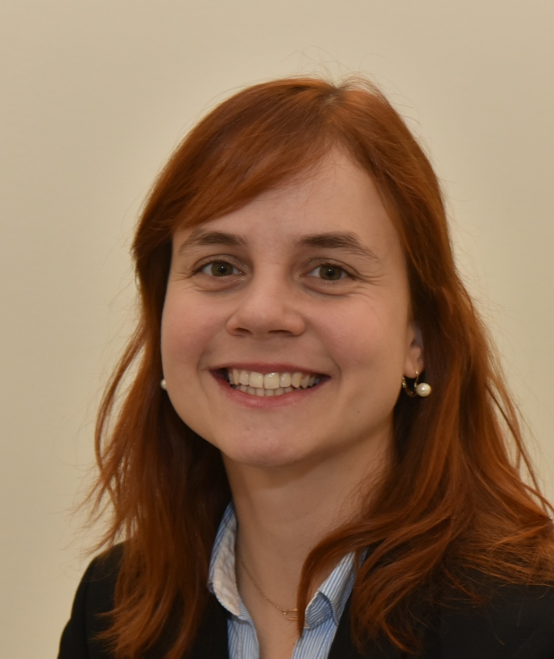
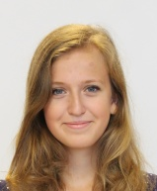
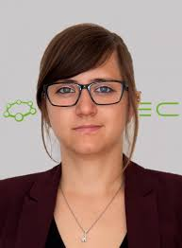
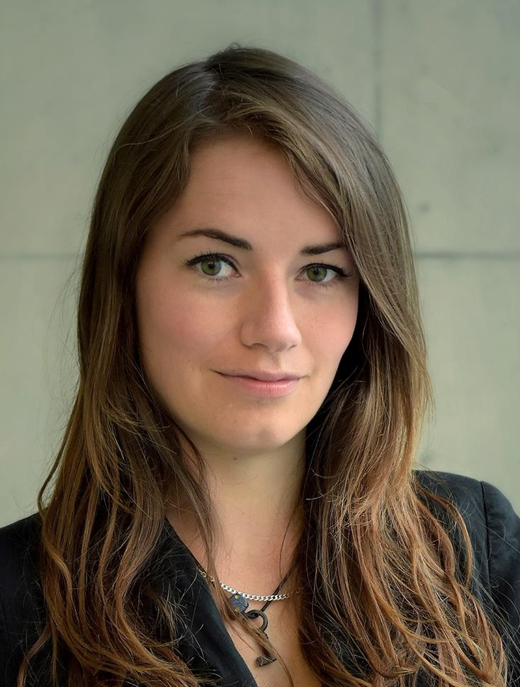
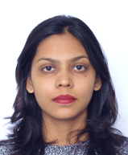
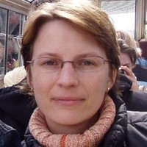
Mi
Milan Brázdil
Martin Pail
Jan Cimbálník
Petr Klimeš
Vojtěch Trávníček
Pavel Jurák
Eva Pešlová
Zuzana Vašíčková
Petra Bencúrová
Marie Kudličková
Shivani Sonawane
Markéta Bébarová
Markéta Bébarová

Slide 6


